Slide 1
Advanced Topics in Artificial Intelligence: Machine Learning and Neural Network Basis
Lecture 2
Anwar Khan

Slide 2
Topics
Machine Learning:
Definition
Important Tasks
Neural Network Basis:
Perceptron
Binary Classification with Perceptron
Training Perceptron

Slide 3
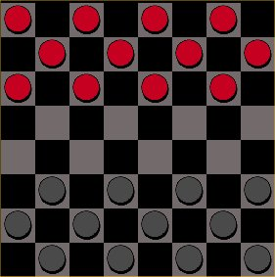
What is Machine Learning ?
Field of study that gives computer the ability to learn without being explicitly programmed (Arthur Samuel, 1956)
Study of algorithms that improve their performance P at some task T with experience E (Tom Mitchell, 1998)
T: Play checkers
P: % of games won
E: Playing against self
Well defined learning task: <P, T, E>

Slide 4
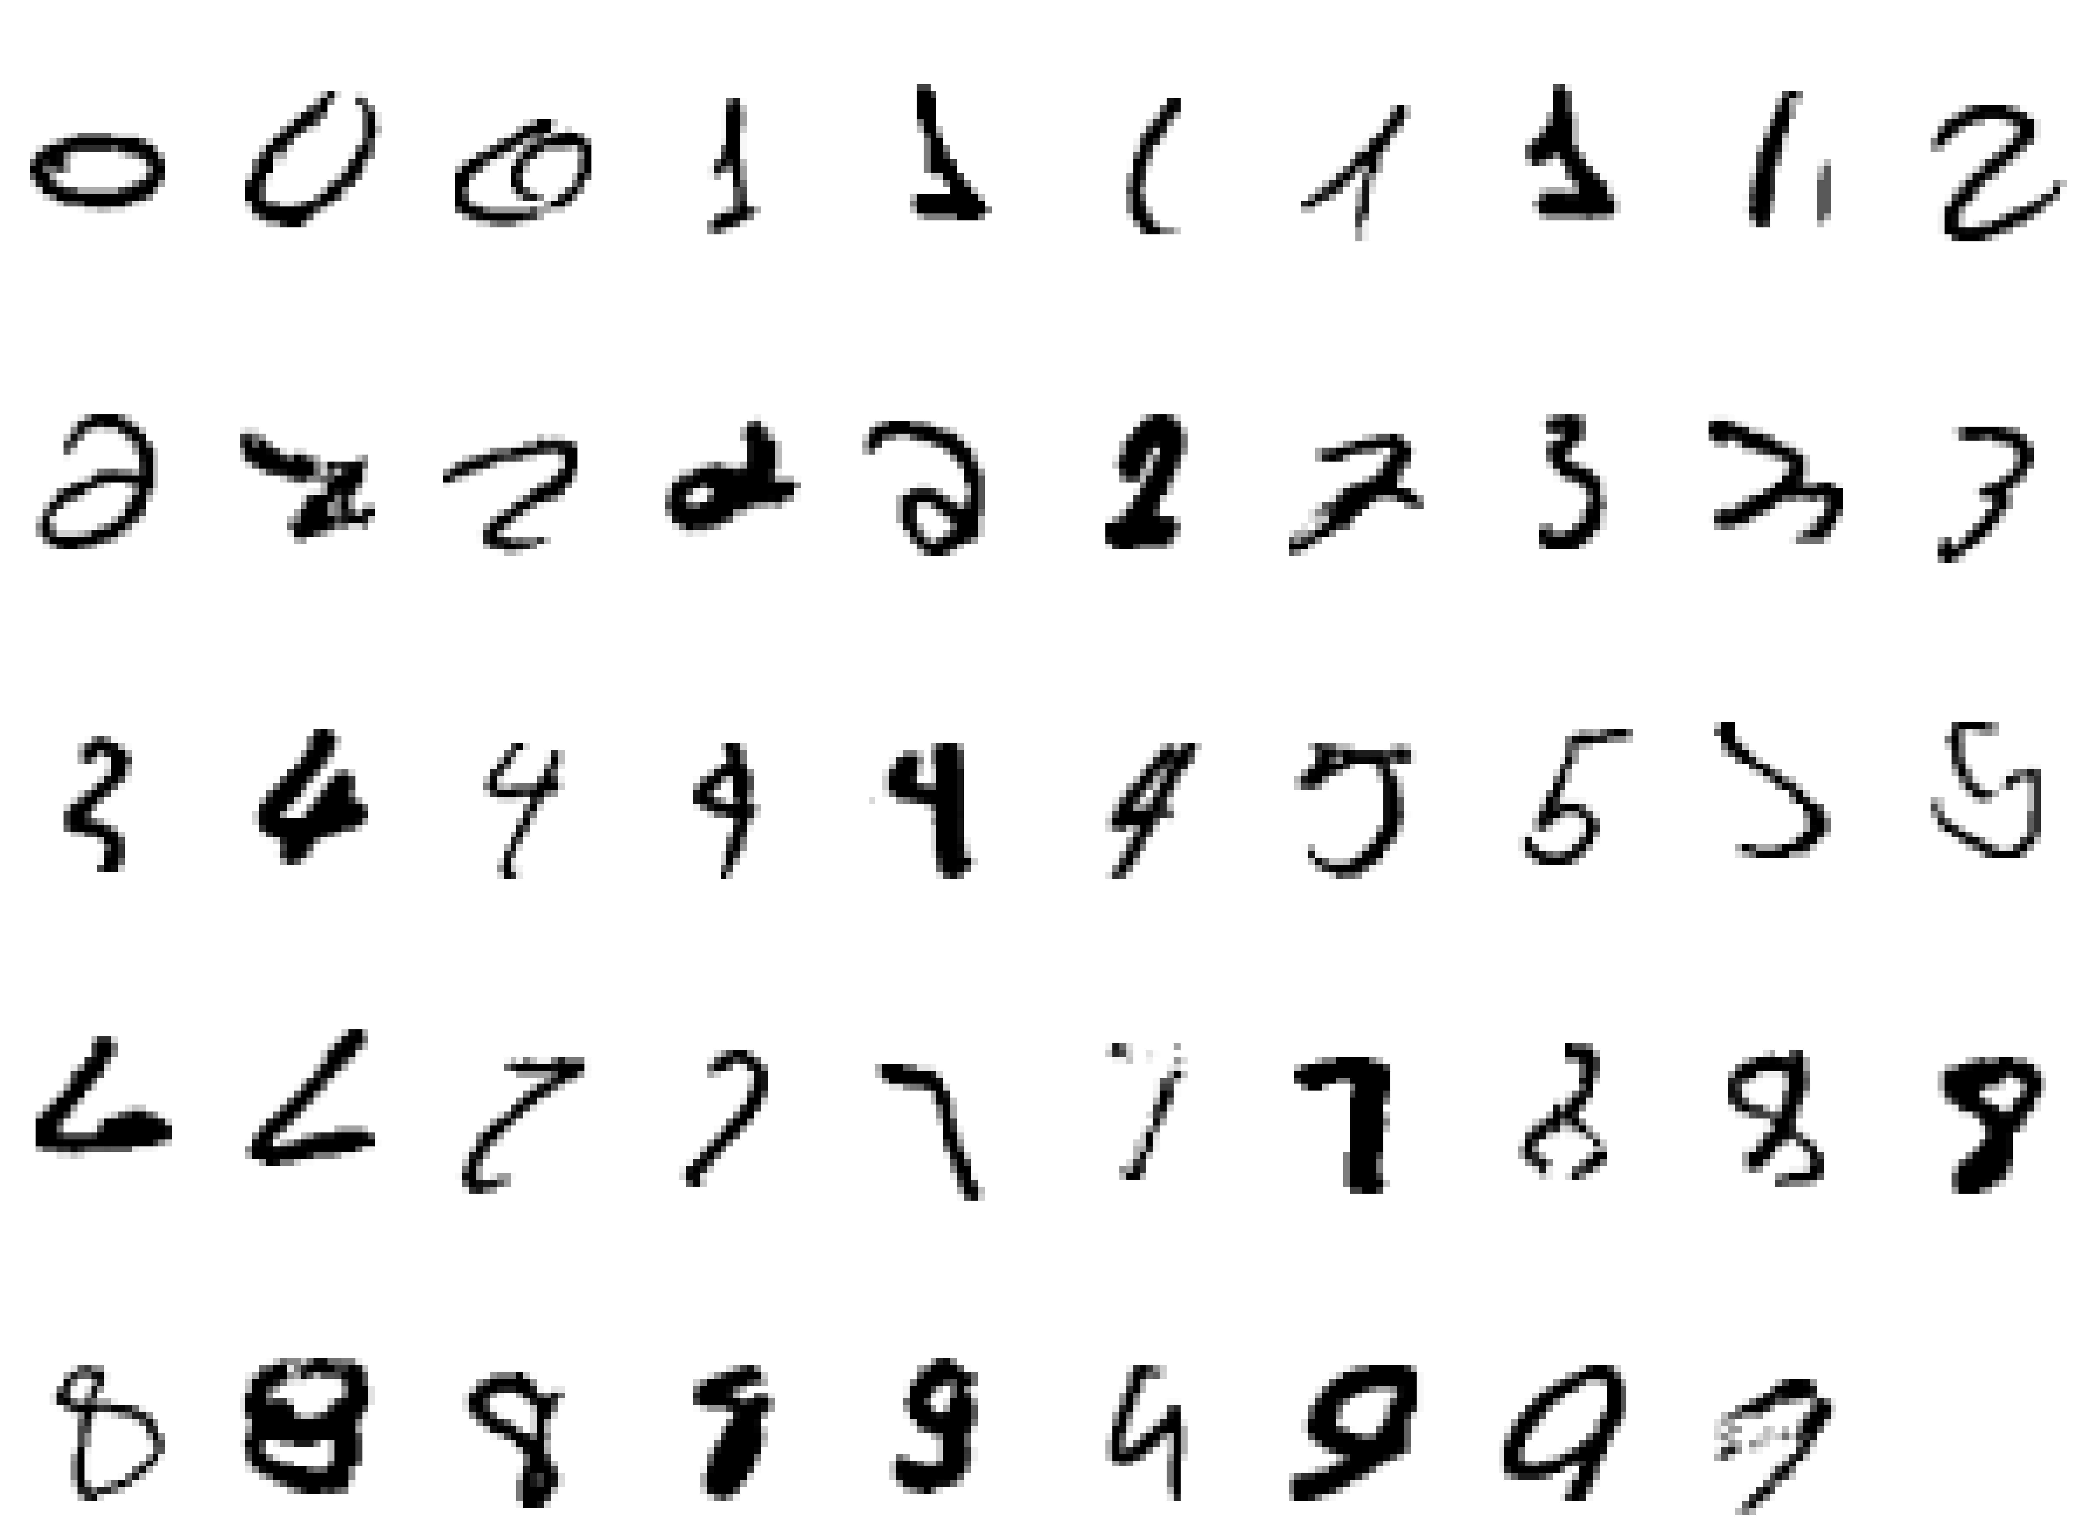
Well Defined Learning Task
Handwriting Recognition
Task T: recognizing and classifying handwritten words within images
Performance P: percent of words correctly classified
Training experience E: a database of written words with given classification

Slide 5
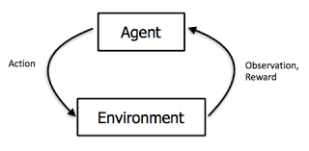
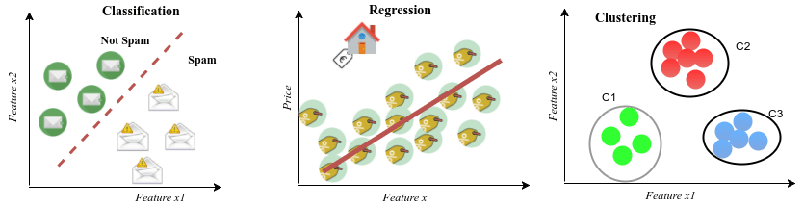
Machine Learning Tasks
Supervised Learning
Classification
Regression
Unsupervised Learning
Reinforcement Learning

Slide 6
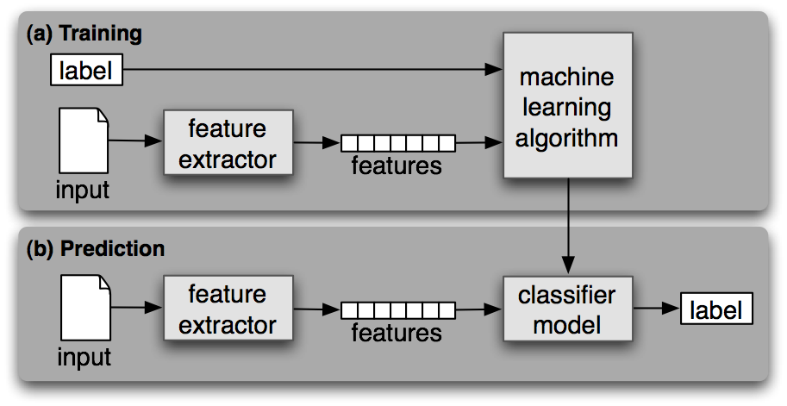
Learning Process

Slide 7
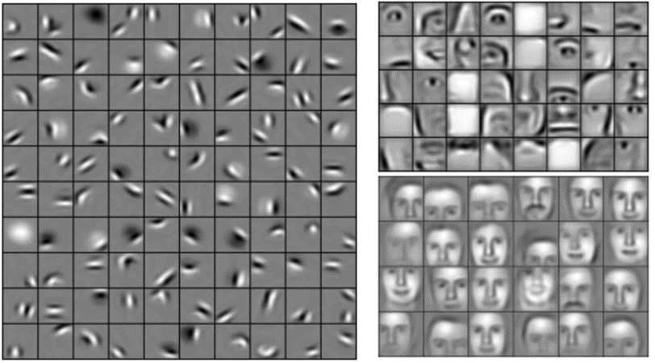
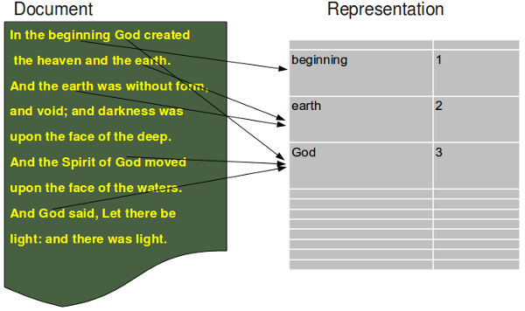
Features

Slide 8
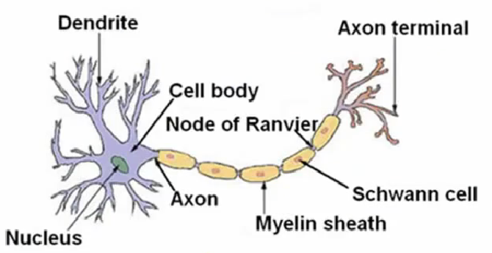
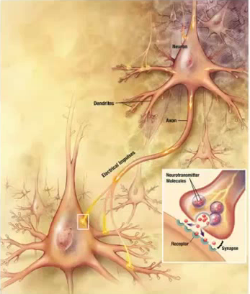
Biological Neuron

Slide 9
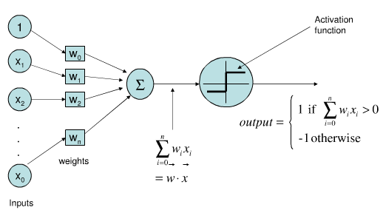
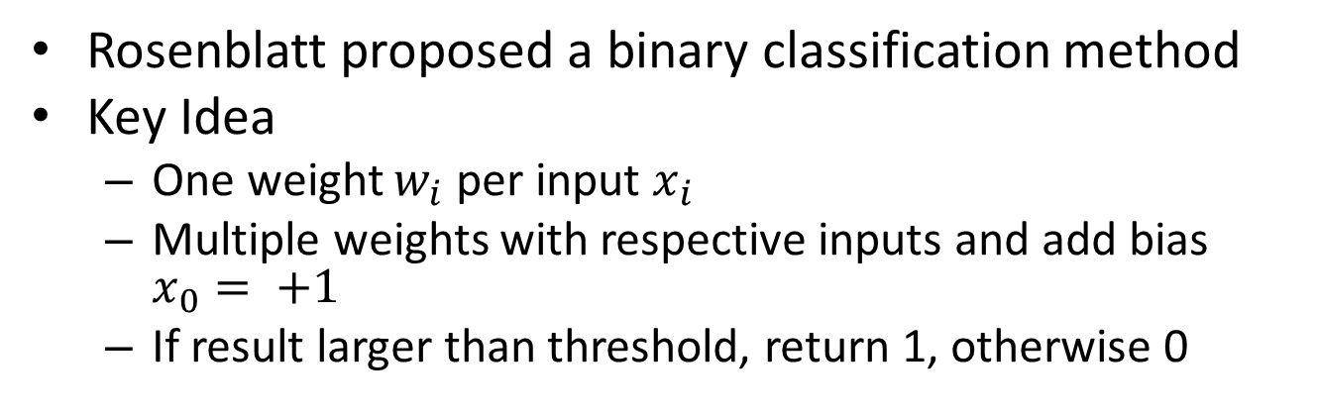
Perceptron
Rosenblatt proposed a binary classification method
Key Idea
One weight $w_{i}$ per input $x_{i}$
Multiple weights with respective inputs and add bias $x_{0}= +1$
If result larger than threshold, return 1, otherwise 0

Slide 10
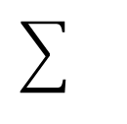
Sentiment Classification
Feature Weights
Good
Good | 1.0
Great | 1.2
Awesome | 1.7
Bad | -1.0
Terrible | -2.1
Awful | -3.3
Restaurant, the, where… | 0.0
….
Great
1.0
1.2
Awesome
1.7
-1.0
Bad
-2.1
Terrible
-3.3
Awful

Slide 11
Sentiment Classification
Feature Weights
Good
Good | 1.0
Great | 1.2
Awesome | 1.7
Bad | -1.0
Terrible | -2.1
Awful | -3.3
Restaurant, the, where… | 0.0
….
Great
1.0
1.2
Awesome
1.7
-1.0
Bad
-2.1
Terrible
-3.3
Awful
Test example: “Mubeen was great, the food was awesome. But the service was terrible”

Slide 12
Sentiment Classification
Feature Weights
Good
Good | 1.0
Great | 1.2
Awesome | 1.7
Bad | -1.0
Terrible | -2.1
Awful | -3.3
Restaurant, the, where… | 0.0
….
Great
1.0
1.2
Awesome
1.7
-1.0
Bad
-2.1
Terrible
-3.3
Awful
Test example: “Mubeen was great, the food was awesome. But the service was terrible”
Positive score: 1.0+1.7-1.3 = 1.4

Slide 13
Sentiment Classification
Feature Weights
Good
Good | 1.0
Great | 1.2
Awesome | 1.7
Bad | -1.0
Terrible | -2.1
Awful | -3.3
Restaurant, the, where… | 0.0
….
Great
1.0
1.2
Awesome
1.7
-1.0
Bad
-2.1
Terrible
-3.3
Awful
Test example: “Mubeen was great, the food was awesome. But the service was terrible”
Positive score: 1.0+1.7-1.3 = 1.4
> 0
Output = 1 (means positive sentiment)

Slide 14
Sentiment Classification with Perceptron
Test example: “Mubeen was great, the food was awesome. But the service was terrible”
Good
Great
Awesome
Bad
Terrible
Awful
…
…
Input:
1 | 0 | 1 | 0 | 1 | 0 | … | … | …
Weights of positive class:
1.0 | 1.2 | 1.7 | -1.0 | -2.1 | -1.3 | … | … | …
Parameters / weights

Slide 15
Sentiment Classification with Perceptron
Test example: “Mubeen was great, the food was awesome. But the service was terrible”
Good
Great
Awesome
Bad
Terrible
Awful
…
…
Input:
1 | 0 | 1 | 0 | 1 | 0 | … | … | …
ₓ
₊
ₓ
₊
ₓ
₊
ₓ
₊
ₓ
₊
ₓ
₌
Weights of positive class:
1.0 | 1.2 | 1.7 | -1.0 | -2.1 | -1.3 | … | … | …
a.k.a parameters of positive class

Slide 16
Fast Sentiment Classification with Perceptron
1
0
1
0
1
0
…
…
Good
Test example: “Mubeen was great, the food was awesome. But the service was terrible”
Great
x:
Asm
Bad
W:
1.0 | 1.2 | 1.7 | -1.0 | -2.1 | -1.3 | … | … | …
Trbl
Awfl

Slide 17
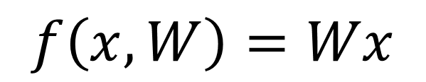
Fast Sentiment Classification with Perceptron
1
0
1
0
1
0
…
…
Good
Test example: “Mubeen was great, the food was awesome. But the service was terrible”
Great
x:
Asm
Bad
W:
1.0 | 1.2 | 1.7 | -1.0 | -2.1 | -1.3 | … | … | …
Trbl
$$f\left(x,W\right)=Wx$$
Awfl

Slide 18
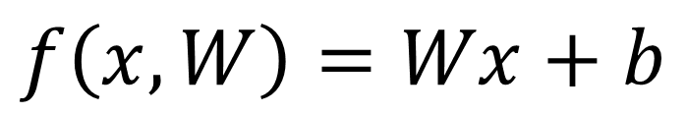
Fast Sentiment Classification with Perceptron
1
0
1
0
1
0
…
…
Good
Test example: “Mubeen was great, the food was awesome. But the service was terrible”
Great
x:
Asm
Bad
W:
1.0 | 1.2 | 1.7 | -1.0 | -2.1 | -1.3 | … | … | …
Trbl
$$f\left(x,W\right)=Wx+b$$
Awfl
Bias

Slide 19
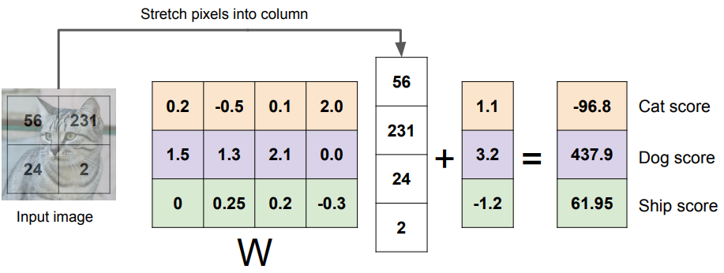
Image Classification with Perceptron
Bias vector
Class scores
Weights/ parameters matrix

Slide 20
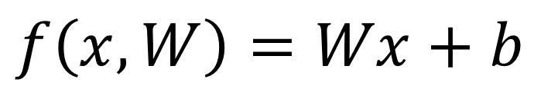
Image Classification with Perceptron
$$f\left(x,W\right)=Wx+b$$

Slide 21
Image Classification with Perceptron
< 0
Not Cate

Slide 22
Image Classification with Perceptron
< 0
Not Cate
What to do?

Slide 23
Image Classification with Perceptron
< 0
Not Cate
Where I did wrong?

Slide 24
Image Classification with Perceptron
< 0
Not Cate
Where I did wrong?

Slide 25
Image Classification with Perceptron
< 0
Not Cate
Ok, how to fix?

Slide 26
Image Classification with Perceptron
< 0
Not Cate
Ok, how to fix?
Ans: Learning Algo.

Slide 27
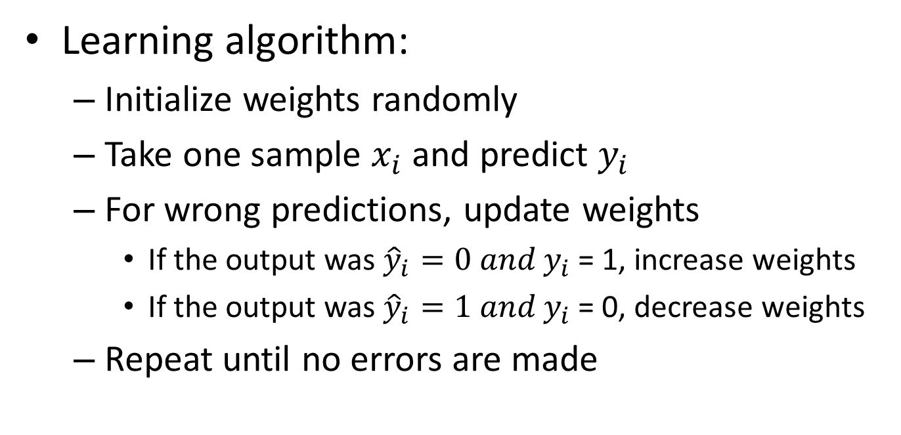
Training a Perceptron
Learning algorithm:
Initialize weights randomly
Take one sample $x_{i}$ and predict $y_{i}$
For wrong predictions, update weights
If the output was ${\hat{y}}_{i}=0 and y_{i}$ = 1, increase weights
If the output was ${\hat{y}}_{i}=1 and y_{i}$ = 0, decrease weights
Repeat until no errors are made

Slide 28
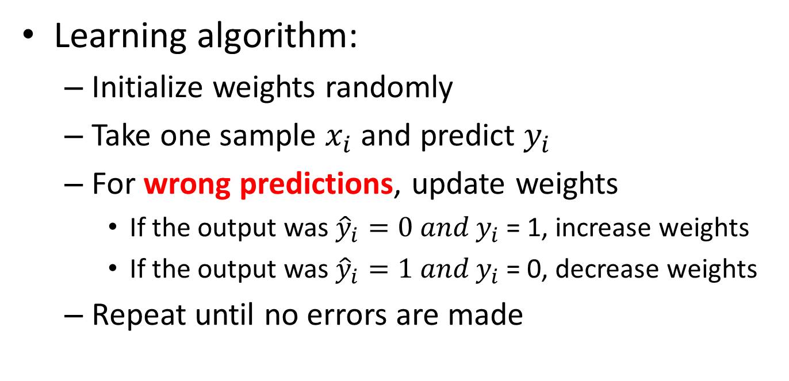
Training a Perceptron
Learning algorithm:
Initialize weights randomly
Take one sample $x_{i}$ and predict $y_{i}$
For wrong predictions, update weights
If the output was ${\hat{y}}_{i}=0 and y_{i}$ = 1, increase weights
If the output was ${\hat{y}}_{i}=1 and y_{i}$ = 0, decrease weights
Repeat until no errors are made
But, how do the algorithm knew that the predictions are wrong?

Slide 29
Training a Perceptron
Learning algorithm:
Initialize weights randomly
Take one sample $x_{i}$ and predict $y_{i}$
For wrong predictions, update weights
If the output was ${\hat{y}}_{i}=0 and y_{i}$ = 1, increase weights
If the output was ${\hat{y}}_{i}=1 and y_{i}$ = 0, decrease weights
Repeat until no errors are made
But, how do the algorithm knew that the predictions are wrong?
Cost function/ loss function tell it

Slide 30
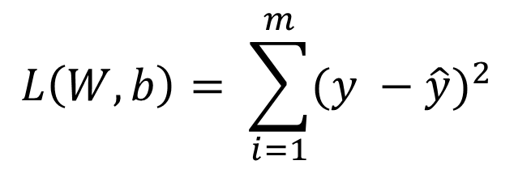
Training a Perceptron
Learning algorithm:
Initialize weights randomly
Take one sample $x_{i}$ and predict $y_{i}$
For wrong predictions, update weights
If the output was ${\hat{y}}_{i}=0 and y_{i}$ = 1, increase weights
If the output was ${\hat{y}}_{i}=1 and y_{i}$ = 0, decrease weights
Repeat until no errors are made
What is Cost function?
$$L\left(W,b\right)= \sum_{i=1}^{m}{{(y −\hat{y})}^{2}}$$

Slide 31
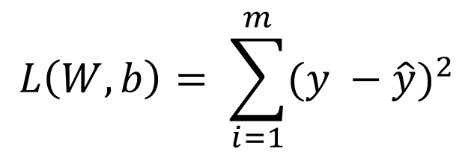
Training a Perceptron
Learning algorithm:
Initialize weights randomly
Take one sample $x_{i}$ and predict $y_{i}$
For wrong predictions, update weights
If the output was ${\hat{y}}_{i}=0 and y_{i}$ = 1, increase weights
If the output was ${\hat{y}}_{i}=1 and y_{i}$ = 0, decrease weights
Repeat until no errors are made
Actual class
Predicted class
$$L\left(W,b\right)= \sum_{i=1}^{m}{{(y −\hat{y})}^{2}}$$
What is Cost function?

